Slide 1
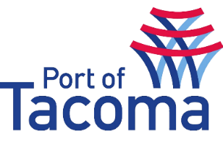
Port of Tacoma | Microsoft Teams Rollout & Governance
What We Did
In Affirma’s continuing relationship with the Port of Tacoma, our team was involved in a Teams Rollout that included a high level of focus around governance and policy creation and implementation.
The Port of Tacoma chose to take a phased approach to the rollout of Teams.
In the first phase we focused solely on the chat and call functionality within Teams as we transitioned the Port off of Skype for Business.
Our second phase in the rollout was centered around Governance and implementing retention policies. The Port had very specific policies defined around data retention based on type of content (Document Type, Contract Type, and Conversations).
Affirma implemented these policies across the tenant and also provided change management and training around the use of the new environment.

